Slide 1
Simulated annealing
Chapter 3

Slide 2
3.1 Motivaitons and remarks

Slide 3
In French: “recuit simulé”
A method obviously inspired by metallurgy ☺
Annealing (“recuit”): slow cooling of a metal object
Quenching (“trempe”): quick cooling of the object
At high temperature, atoms of metal are moving fast
Annealing
Quenching
Organized in a regular structure of low (minimal) energy
Atoms are quenched in local energy minima

Slide 4
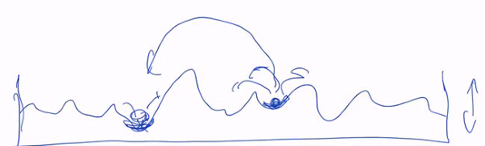
Simulated annealing aims to use the same process for computer problem in order to find a solution of minimal fitness (here fitness = energy).
This is a metaheuristics inspired by physics: nature tends to minimize energy!
Example: “shaking” a ball to find the point where it fall and stabilize with minimal energy

Slide 5
3.2 Algorithm

Slide 6
Algorithm
We want to minimize a function called here Energy and noted E (instead of Fitness).
As usual one has to specify the Search space S and to define the Neighbourhood: movements or transformations need to be specified.
One specified an initial condition (configuration) to start the search.
Specificity of SA (Simulated annealing)
At each iteration one pick a neighbour at random.
It become the new current solution with probability p (Math definition):
P = min(1, e^{-ΔE/T})
Where ΔE is the variation of energy compare to the current solution:
ΔE = E_{new} – E_{old}
This relation to compute p is called the Metropolis rule.
We accept the new solution if (Computer Sciences implementation):
random (0,1) < e^{-ΔE/T}
With probability 1-p the new solution is rejected. Then we need to generate a new one.

Slide 7
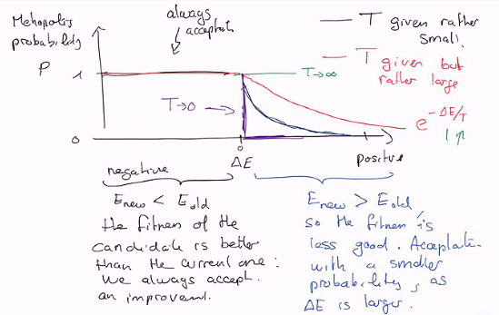
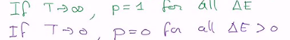
T is a parameter of SA, actually one of the guiding or control parameters.
If T is big, we’re most encline to accept the new solution.
But as T is larger, the acceptation probability of a less quality energy is larger.
At the beginning of the search T is high and we favour exploration.
As iterations go on, temperature is decreased according to a temperature schedule
Then the search will focus on intensification: only improvement will be accepted.
Exploration ------> Exploitation (as T decrease)

Slide 8
Flow chart
START
Generate Scurrent (initial solution)
Set initial Temperature T
Niter = 0
Naccept = 0
Generate Snew
Niter ++
← At random among neighbours
if rand(0,1) < exp(-ΔE/T):
Scurrent = Snew
Naccept ++
No
Equilibrium state?
← See later for a precise definition
Yes
Reduce T
End
condition?
Output Scurrent
STOP
Yes

Slide 9
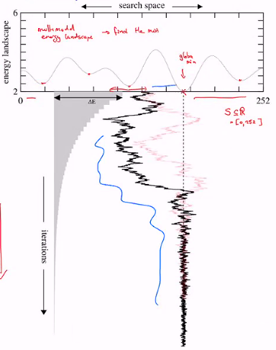
Examples
In grey the jump high with probability 0,5 according to Metropolis rule.
In black and light red, two trajectories (two runs of SA algorithm).
← trajectory

Slide 10
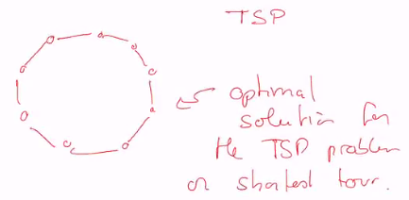
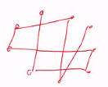
Shortest path through points (TSP)
What is the shortest path going through all the points?
Circle around. Length ~2ΠR (exact solution is a polygon with n sides)
But for an algorithm this is not obvious…
It will start from an initial condition, that can be improved step by step.
In this example, we know the optimal solution and we can test the quality of SA

Slide 11
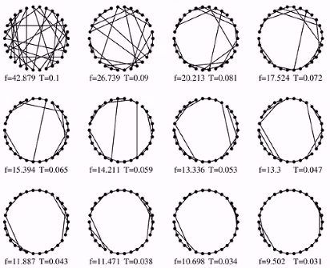
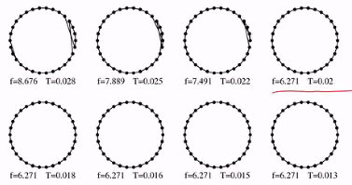
In this simulation, we have:
30 points
Lower T by 10% every 20 acceptations (Naccept)
With high T, it’s easy to make big changes (jumps)
SA found the optimal value, but it does not know.
Further iterations do not improve E, even through T keep decreasing.
Suggest a way for end condition: no more improvement, despite that T is still lowered.

Slide 12
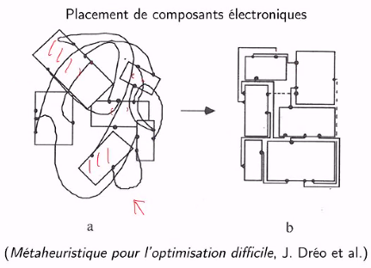
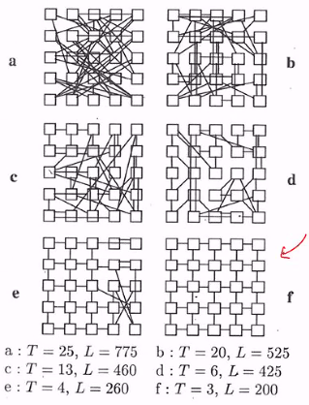
Electronic componant placement
Minimize the length of connections, wires.
Is it the global min? We do not know but it’s clearly a good solution.
Minimize connection wires length
What is the scale of T?
Metropolis gives: e^{-ΔE/T}
=> The scale of T depends on the scale of E

Slide 13
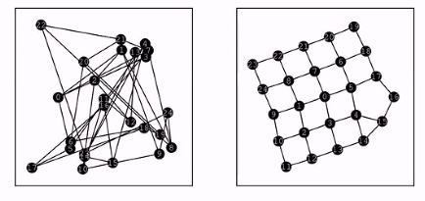
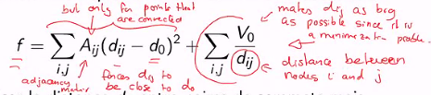
Graph drawing
Represent a graph to minimize the intersections of edges
Movements means moving one of the graph’s node

Slide 14
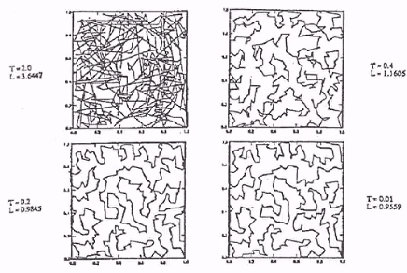
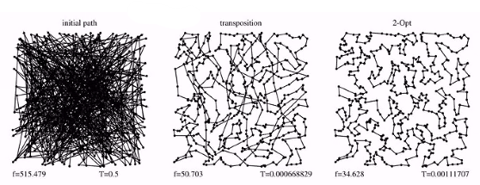
TSP with 400 towns
TSP with 500 towns
Optimal length is L=33,0015
With algorithm Concorde
Transposition is a «swap» method
2-opt is another type of movement
http://www.math.uwaterloo.ca/tsp/index.html
http://www.math.uwaterloo.ca/tsp/world/countries.html

Slide 15
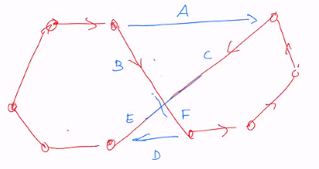
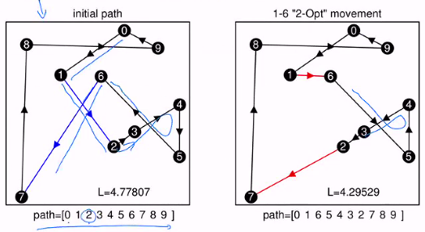
2-opt movements
Example: triangle inequality
Red tour cost: B+F+C+E+rest
Blue tour cost: A+D+rest
but B+C >= A
and E+F >= D
The 2-opt movement is one that resolves such a “bad nosing”
In this example, we do a swap (between 2 and 6),
But we also delete 2 moves (in blue) and add two others (in red).
It cause movements between 3-4-5 to become 5-4-3 (inverse) It is more that a simple “swap” method.

Slide 16
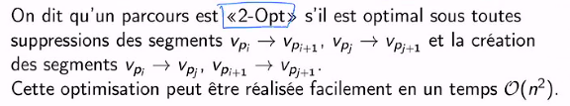
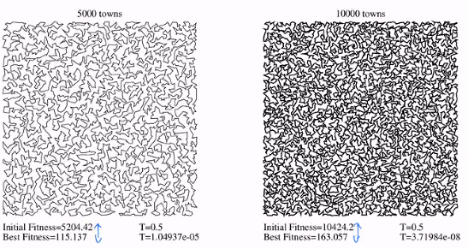
Definition of 2-opt movement:
Examples TSP with 5’000 and 10’000 towns and 2-opt optimization
Performances
Concorde algorithm takes 40 seconds to solve 500 towns problem on a 2017’s laptop (L = 33,…)
SA takes 1 second on the same laptop, with 5% error (L = 36,…)

Slide 17
3.3 Convergence of SA

Slide 18
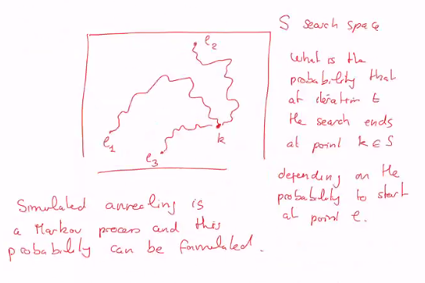
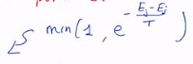
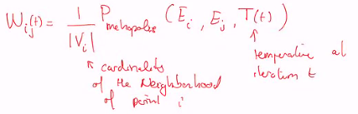
Introduction

Slide 19
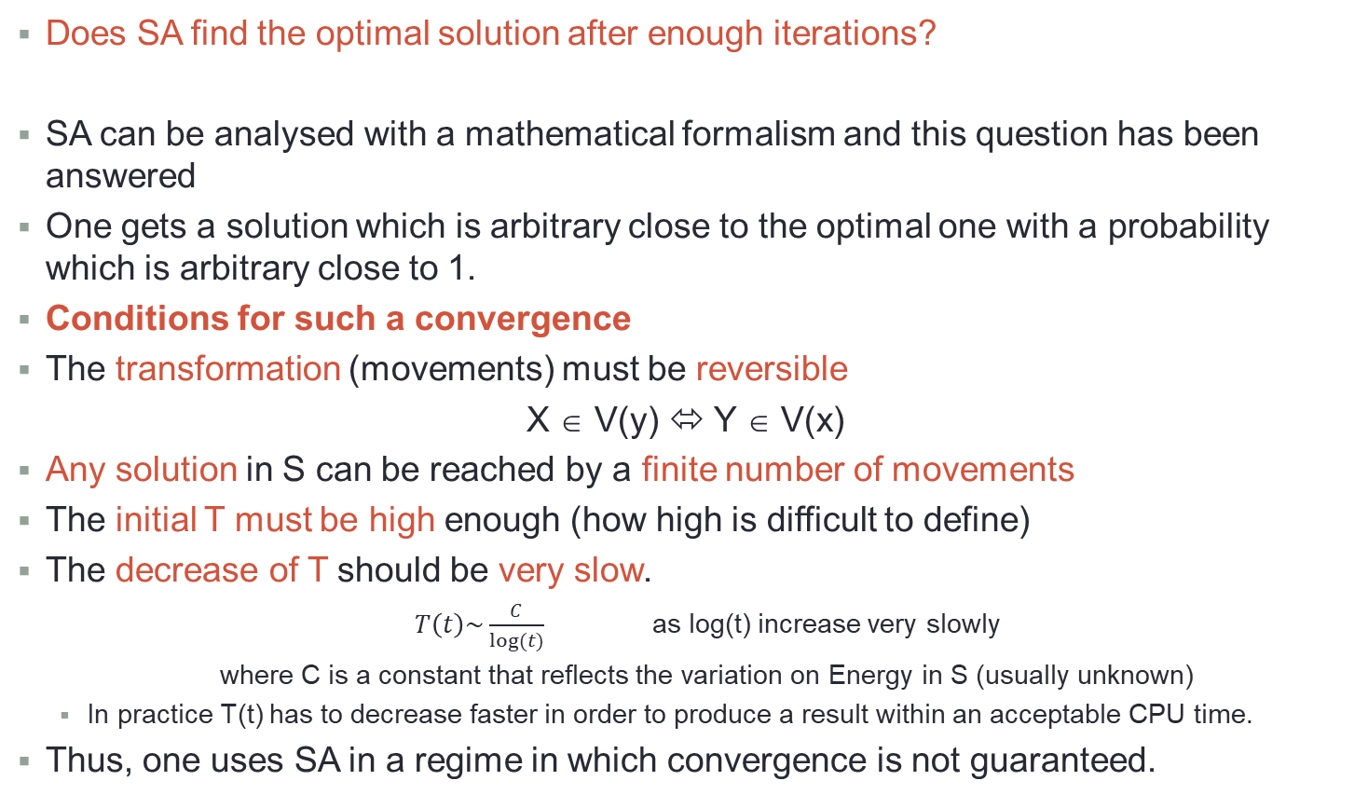
SA convergence in probability
Does SA find the optimal solution after enough iterations?
SA can be analysed with a mathematical formalism and this question has been answered
One gets a solution which is arbitrary close to the optimal one with a probability which is arbitrary close to 1.
Conditions for such a convergence
The transformation (movements) must be reversible
X ∈ V(y) ⬄ Y ∈ V(x)
Any solution in S can be reached by a finite number of movements
The initial T must be high enough (how high is difficult to define)
The decrease of T should be very slow.
$T\left(t\right)\sim \frac{C}{log⁡(t)}$ as log(t) increase very slowly
where C is a constant that reflects the variation on Energy in S (usually unknown)
In practice T(t) has to decrease faster in order to produce a result within an acceptable CPU time.
Thus, one uses SA in a regime in which convergence is not guaranteed.

Slide 20
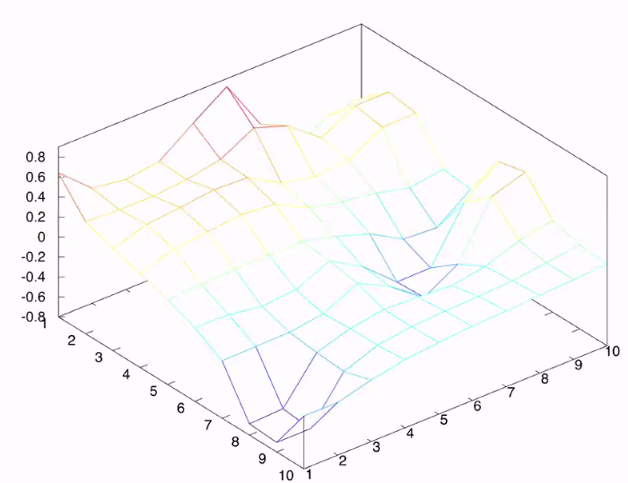
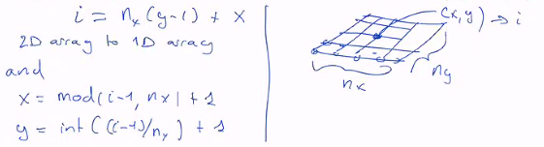
These results can be demonstrated with advanced math. Here we will illustrate the idea through an example:
S = {1,…,10} x {1,…,10}
Neighbours:
V(x,y) ∈ {(x+1,y),(x-1,y),(x,y+1),(x,y-1)}
Notation:
we can denote the elements of S by a single integer:
So S contains 100 points, and i goes from 0 to 99
|S| = 10 x 10 = 100
Energy
Global min is (x,y) = (9,2)
There is a local min in (x,y) = (6,7) that can attract the algorithm

Slide 21
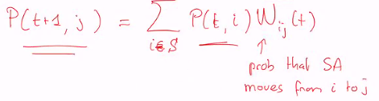
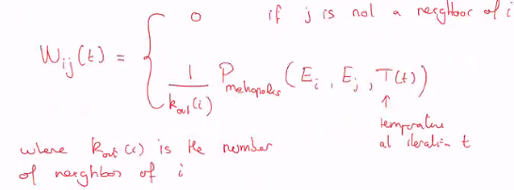
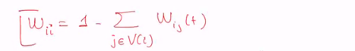
Let P(t,i) be the probability that the current solution of SA is i at iteration t.
As t → ∞ we would like that P peaks on top of i_{opt} and be zero every where else.
How can we express the evolution of P due to SA?
W_{ij} is a matrix of size 100x100 as it’s equal to (n_{x} x n_{y}) x (n_{x} x n_{y})
W_{ij} is defined by the Metropolis rule:

Slide 22
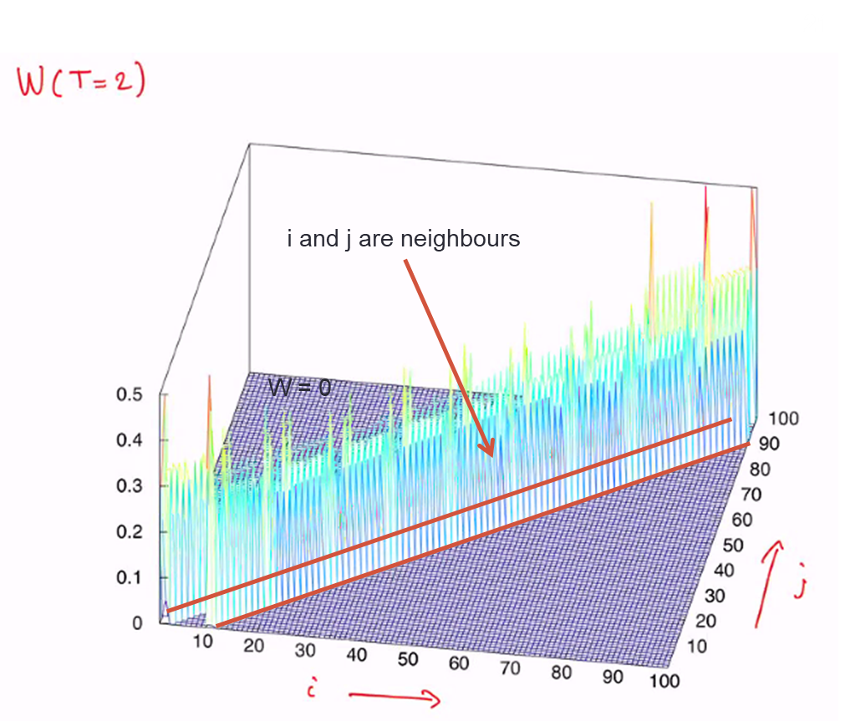
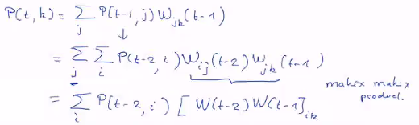
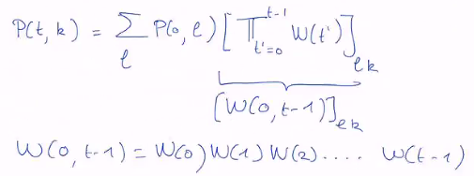
Let see how P(t,i) evolves at t goes on, for our specific example
Ideally we want to compute P(t,k) as a function of P(t=0,l)
where e is the initial configuration
To describe the move of SA over two steps we need to use W(t-2)W(t-1)
By iterating this process, one gets:
W(t1) ≠ W(t2) as T is changing over time
If T(0) is large enough, W(0,t-1) does not depends on the starting point.

Slide 23
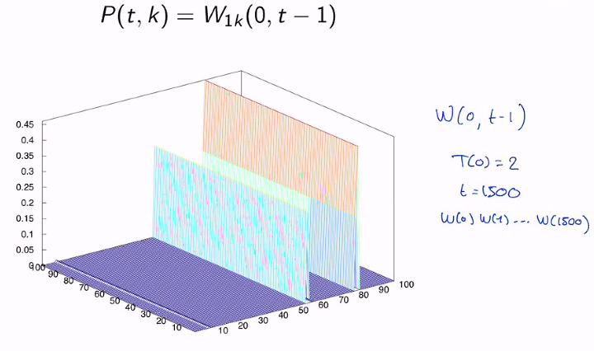
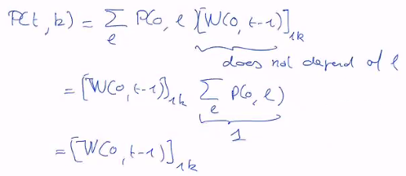
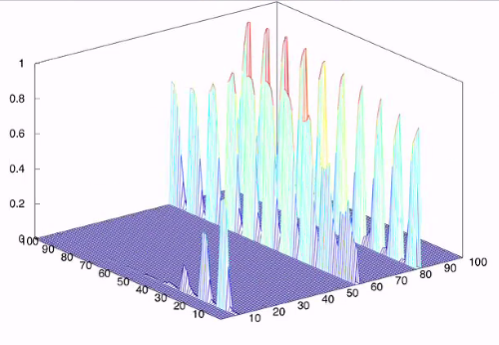
First: T(0) = 2 and t = 1500
If T(0) is large enough, we observe that W(0,t-1) has all its rows identical
This is independent on the initial condition.
That’s why one need a high enough initial T
If T(0) = 0,5
We see that there is dependences on both axis if initial T is too low.
Only depends on this axis j

Slide 24
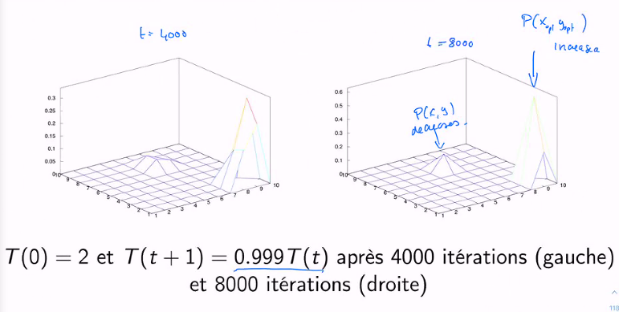
Conclusion
The smaller you decrease T and the longer you process it, the better you converge.

Slide 25
3.4 Practical guide to SA
Useful tip to implement Simulated Annealing

Slide 26
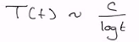
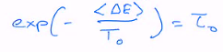
Actually the mathematical constraints to ensure convergence of SA is not applicable:
Too much CPU time needed way tpp slow.
In practice we use a different temperature schedule.
Define S and code the possible solutions
Specify movements or transformations
with ΔE easy to compute as you’ll need to compute it a lot of time
Choose a random initial condition
Choose the initial Temperature (not an obvious thing)
Perform randomly 100 transformations starting from the initial configuration
Compute along this path <ΔE> the average variation of Energy
Choose an initial acceptation rate τ₀ of movement that degrade the Energy For instance, it’s recommended to take: → τ₀ = 0.2 if the initial condition is of good quality → τ₀ = 0.5 if the initial condition is of poor quality Then T₀ is computed as follow:

Slide 27
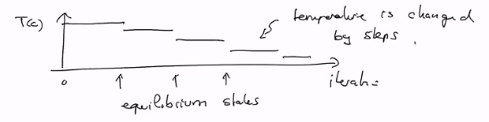
5. Temperature change (Temperature schedule):
Temperature is reduced when an equilibrium state is reached
An equilibrium state is defined as follows:
One has accepted 12N movements where N is the problem size, or
Attempted 100N N_{accept} and N_{attempt} in the flow chart
In case of an equilibrium state, T is decreased as:
T_{k+1} = 0.9T_{k}
6. End condition
If during 3 consecutive temperature levels, the Energy E does not improve, the search stops.
One output the last solution
7. Validation
To ensure that the optimal Energy obtained with SA is good, it’s recommended to run it a second time.
E_{opt} should be the same, but X_{opt} ∈ S can vary because there might be several solutions.

Slide 28
3.5 Parallel tempering
A parallel version of SA.
Proposed in 1991 by Geger Watkins on protein folding
It’s a process in which a sample is cooled down then re-healed, then cooled down again.

Slide 29
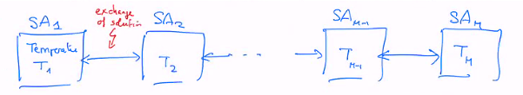
Setup of parallel tempering
M copies (replica) of a SA for the same problem.
Each copy has its own, almost constant, temperature (as opposed to the SA we’ve seen before).
The copies have the following properties:
T₁ < T₂ <… T_{M-1} < T_{M}
The cooling or heating is obtained by moving a solution towards a SA with lower or higher Temperature.
Therefore each SA can exchange their current solution according to a given rule.
Only SA with neighbouring temperatures can exchange their solutions.

Slide 30
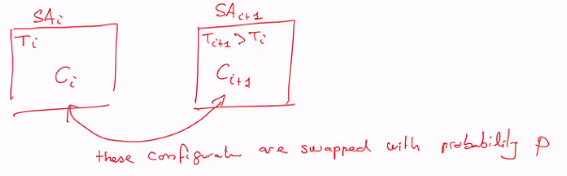
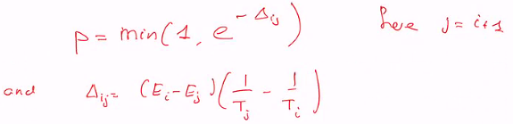
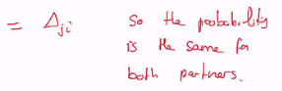
Configuration swap

Slide 31
Interpretation
If a SA at high Temperature contains a solution which is better than its neighbour SA at lower Temperature, then exchange is done with P = 1.
➔ good solutions goes to lower Temperatures to be better exploited.
This is the exploitation / intensification process
But the expression of P also allow good solutions to move to higher Temperature:
This favour exploration / diversification
This P is smaller and smaller as ΔE is larger

Slide 32
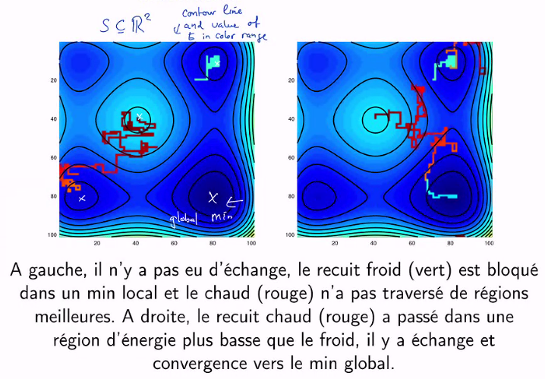
Illustration

Slide 33
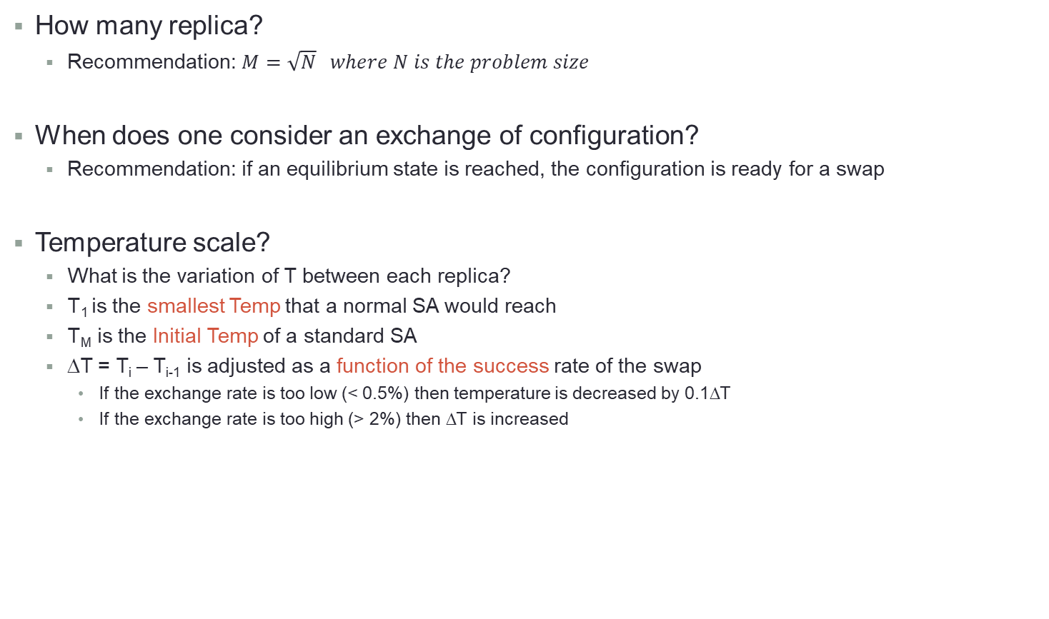
Guiding parameters
How many replica?
Recommendation: $M=\sqrt{N} where N is the problem size$
When does one consider an exchange of configuration?
Recommendation: if an equilibrium state is reached, the configuration is ready for a swap
Temperature scale?
What is the variation of T between each replica?
T₁ is the smallest Temp that a normal SA would reach
T_{M} is the Initial Temp of a standard SA
ΔT = T_{i} – T_{i-1} is adjusted as a function of the success rate of the swap
If the exchange rate is too low (< 0.5%) then temperature is decreased by 0.1ΔT
If the exchange rate is too high (> 2%) then ΔT is increased

